Slide 1
SSWH4:
The student will analyze the importance of the Byzantine and Mongol empires between 450 CE and 1500 CE.

Slide 2
http://www.biography.com/people/genghis-khan-9308634/videos/genghis-khan-a-ruthless-legacy-2202651761
http://www.biography.com/people/marco-polo-9443861/videos/marco-polo-an-amazing-tale-2080070187

Slide 3
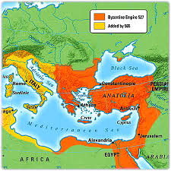
BYZANTINE EMPIRE:
Eastern part of Roman Empire
Capital: Constantinople (Modern day Istanbul, Turkey)
Preserved Roman ideas & culture
Key trading spot between Europe & Asia
East and West grew apart b/c: distance and lack of communication
  West spoke Latin and East spoke Greek

Slide 4
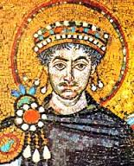
JUSTINIAN:
Justinian’s Code:
-laws passed that modeled ancient Rome
-spread to Western Europe, helped create international law
Government:
-Autocrat: sole ruler, complete authority
Religion:
-Orthodox Christianity

Slide 5
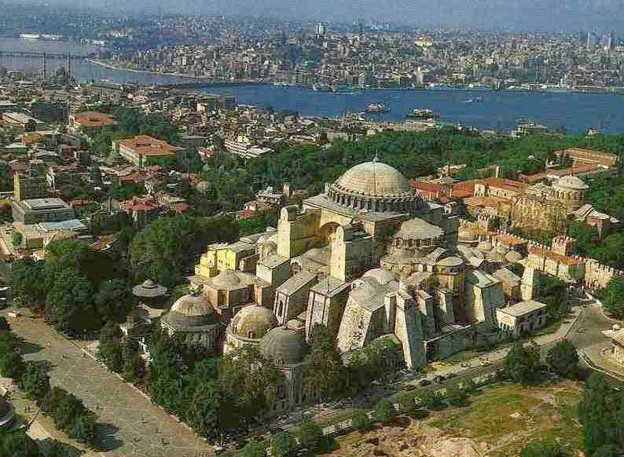
JUSTINIAN:
FOCUSED ON THE ARTS:
RELIGIOUS ART
CHURCH BUILDINGS (MOST FAMOUS, HAGIA SOPHIA)
PAGE 284

Slide 6
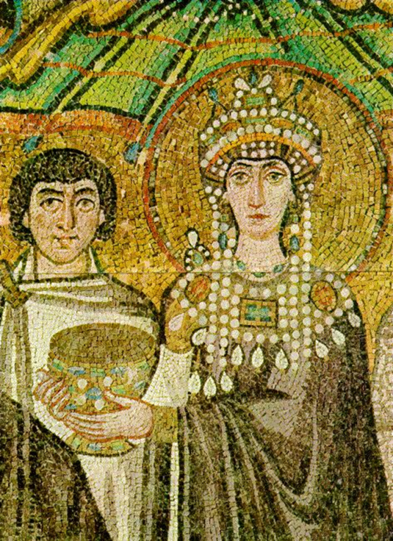
THEODORA
Wife of Justinian
Partner in politics, advisor
Intelligent
Challenged Justinian
Pursued her own policies
Increased role of women in society

Slide 7
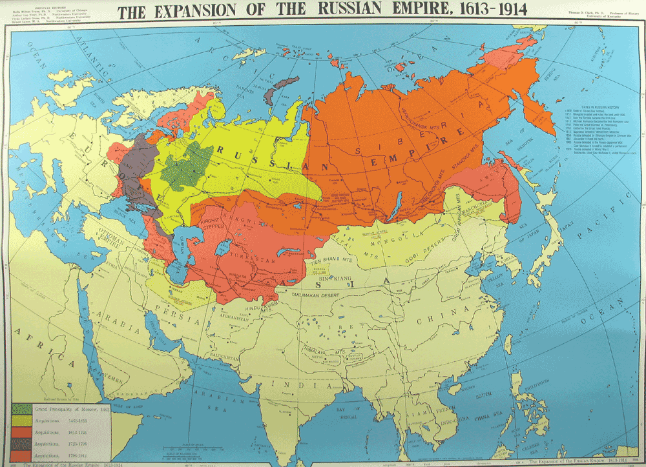
RISE OF RUSSIAN EMPIRE:
Extensive network of rivers provided transportation for both people & goods
Helped link Russians to Byzantine Empire
Kiev (present day capital of Ukraine) became cultural center of Russian Empire
Adopted Orthodox Christianity
Cyrillic Alphabet: used in Russia, based on Greek alphabet

Slide 8
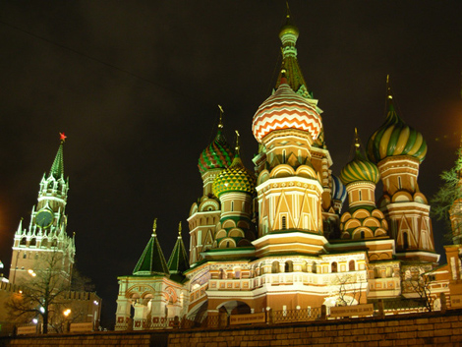
RUSSIAN ART/ARCHITECTURE:
  Art, music, and architecture (domes) in Russia reflected Byzantine influence.

Slide 9
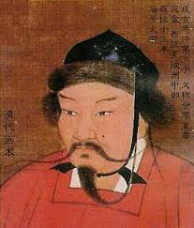
MONGOL RULE:
Mongols: nomadic group that took over Russia
Leader: Genghis Khan (united Mongol tribe)
Golden Horde: burned Kiev & other towns
Ruled for 150 years
Took over brutally, but allowed the government to stay intact as long as they paid heavy tribute to the Mongol rulers.

Slide 10
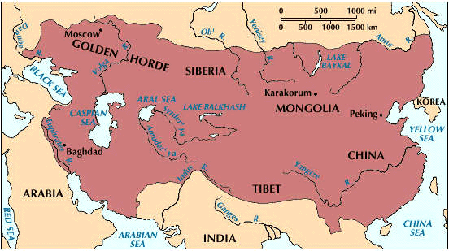
MONGOL RULE:
Kublai Khan:
  Genghis’s grandson who invaded China.
  Took over the Chinese government and established an all-Mongol government.

Slide 11
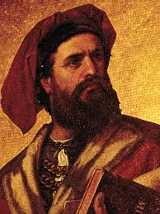
MARCO POLO:
  Merchant from Italy who visited China during Mongol rule.
  Wrote a book describing how impressive the Mongols were.
    Made Europeans interested in China.

Slide 12
MOSCOW TAKES THE LEAD:
Mongol power decreases, Moscow princes take over
Ivan the Great (Ivan III):
-absolute ruler
-referred to himself as a tsar (Russian word for Caesar)
Ivan the Terrible (Ivan IV):
-grandson of Ivan the Great
-violent, trusted no one
-absolute ruler
-left land in rebellion

Slide 13
THE GREAT SCHISM:
  1054: Split in Christianity
  Argument arose between Church leaders.
  The Christian Church split into two parts:
    The Roman Catholic Church
      Western Europe
      Centered in Rome
      The Pope became the Leader
    The Eastern Orthodox Church
      Eastern Europe
      Centered in Constantinople
      The Patriarch became the Leader

Slide 14
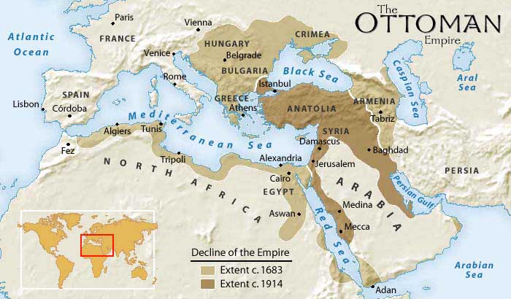
OTTOMAN EMPIRE:
Ottomans: Turkish-speaking nomadic group (from Central Asia)
Attempted to take over the crumbling Byzantine Empire, successful in 1453.
Sieged Constantinople, renamed it Istanbul, and made it the capital of the Ottoman Empire

